Slide 1
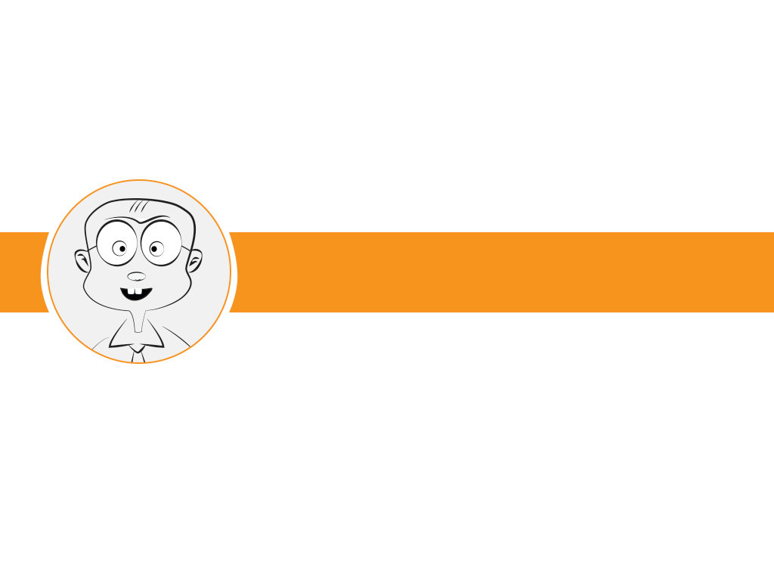

TOPLECTURE 5: exception & interrupt
EMBEDDED SYSTEM COURSE
Notes:
Questions:
PC register align theoe word/halfword/byte? Tại sao ?
What is the different between Thumb & Thumb-2.
What is the different between Handler mode & Thread mode.
Introduce some keyword:
What is interrupt/exception ?
Interrupts are events typically generated by hardware (e.g., peripherals or external input pins) that cause changes in program flow control outside a normal programmed sequence (e.g., to provide service to a peripheral).
In ARM terminology, an interrupt is one type of exception. Other exception kinds are: fault exception// sysTick Timer exception // system exeption support OS (SVC instruction); etc.
What is the exception handler? The pieces of program code that handle exceptions. They are part of the compiled program image.
Cortex-M processors provide a Nested Vectored Interrupt Controller (NVIC) for interrupt handling.
The lecture focuses on NVIC implementation & exception management.

Slide 2
Learning Goals
Describe detail about the Cortex-M interrupt handling (to be more specific: NVIC controller).
Describe about the exception entry/return sequence and how to optimize the interrupt latency.
Notes:
Cortex-M provides a Nested Vectored Interrupt Controller (NVIC) for interrupt handling.
Exception entry sequence: Staking, Update registers, Fetch vector number & instruction of exception handler.
Exception return sequence: Unstacking, Fetch & execute from the restored return address
Exception handling optimization: Tail chaining, Late arrival, pop preemption.

Slide 3

Table of contents
Overview of interrupt management
Vector Table
Details of NVIC & SCB registers
Exception Sequence
Exception handling optimization
Summary
Notes:
Giới thiệu nội dung tổng quan bài giảng: (Gồm 5 phần chính)
1- Tổng quan chung về quản lý ngắt trong ARM-Cortex M
2- Khái niệm Vector Table / Vector table relocation/ Implement Vector table.
3- Giới thiệu chi tiết về các thanh ghi phục vụ cho việc quản lý ngắt trong khối NVIC và SCB
4- Quá trình khi xảy ra một exeption
5- Interrupt lantency và các cơ chế giảm interrupt latency của ARM-Cortex M
(Khái niệm Interrupt latency: Là thời gian tính từ khi interrupt xảy ra tới khi trình phục vụ ngắt bắt đầu được thực hiện)
6- Tổng kết lại buổi học

Slide 4
Table of contents
Overview of interrupt management
Vector Table
Details of NVIC & SCB registers
Exception Sequence
Exception handling optimization
Summary

Slide 5
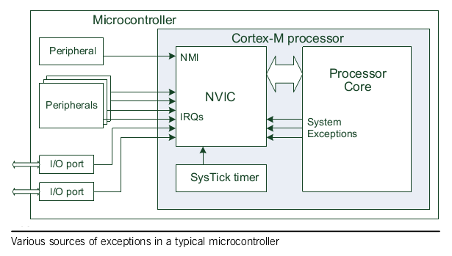
Overview of interrupt management
Exception sources
Notes:
All Cortex-M processors provide a Nested Vectored Interrupt Controller (NVIC) for interrupt handling. The component receives interrupt requests from various sources: Peripherals & System (such as: from processor core (hard fault, SVC instruction, etc), system tick)

Slide 6
Overview of interrupt management
System Exceptions and Interrupt
Excp. Number | Exception Type | Priority
1 | Reset | -3 (highest)
2 | NMI | -2
3 | Hard Fault | -1
4 | MemManage Fault | Programmable
5 | Bus Fault | Programmable
6 | Usage Fault | Programmable
7-10 | Reserved | NA
11 | SVC | Programmable
12 | Debug Monitor | Programmable
Excp. Number | Exception Type | Priority
13 | Reserved | NA
14 | PendSV | Programmable
15 | SysTick | Programmable
16 | Interrupt #0 | Programmable
17 | Interrupt #1 | Programmable
…
47 | Interrupt #31 | Programmable
…
255 | Interrupt #239 | Programmable
Notes:
Note: ARM Cortex M0/M1: support 32 interrupt sources; M3/M4: up to 240.
Reset, NMI, Hard Fault: fix priority.

Slide 7
Overview of interrupt management
Exception Properties
Exception number: Identification for the exception
Vector address: Exception entry point in memory
Priority level: Determines the order in which multiple pending exceptions are handled

Slide 8
Table of contents
Overview of interrupt management
Vector Table
Details of NVIC & SCB registers
Exception Sequence
Exception handling optimization
Summary

Slide 9
Vector Table
Vector Table:
After powerup, vector table is located at 0x00000000
Vector table contains:
Initial value for Main Stack Pointer
Handler vector addresses
Address | Exception Number | Value (Word Size)
0x00000000 | - | MSP initial value
0x00000004 | 1 | Reset vector
0x0000008 | 2 | NMI handler starting address
0x000000C | 3 | Hard fault handler starting address
…… | ……. | Other handler starting address

Slide 10
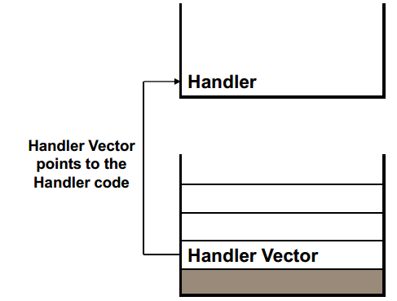
Vector Table
Vector Table Usage:
In the case of an exception, the core:
Reads the vector handler address for the exception from the vector table
Branches to the handler

Slide 11
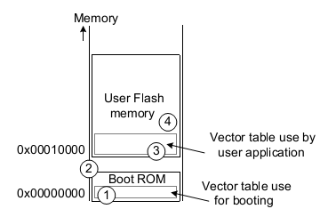
Vector Table & Vector Table Relocation
Vector Table Relocation:
Vector table can be relocated to change interrupt handlers at run-time
Some cases using vector table relocation feature:
Boot loader
Applications load to RAM
Dynamic changing of Vector
Notes:
Example for vector table relocation :
Devices with boot loader
The boot loaders are often pre-programmed in the boot ROM by the microcontroller manufacturer. When the microcontrollers start, they first execute
the boot loader code in the boot ROM, and before branching to the user application in the user flash, the VTOR is programmed to point to the starting point of the user flash memory so that the vector table in user flash will be used.
Boot loader Step
1) Boot up using vector table in boot ROM
2) Carry out boot loader tasks
3) Program VTOR to point to vector table in user flash
4) Branch to the reset handler indicated by the vector table of user flash memory

Slide 12
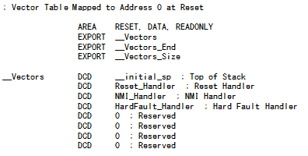
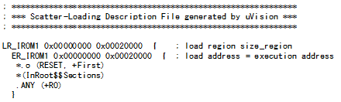
Vector Table
Vector Table Implementation (Startup.s & linker file):

Slide 13
Table of contents
Overview of interrupt management
Vector Table
Details of NVIC & SCB registers
Exception Sequence
Exception handling optimization
Summary

Slide 14
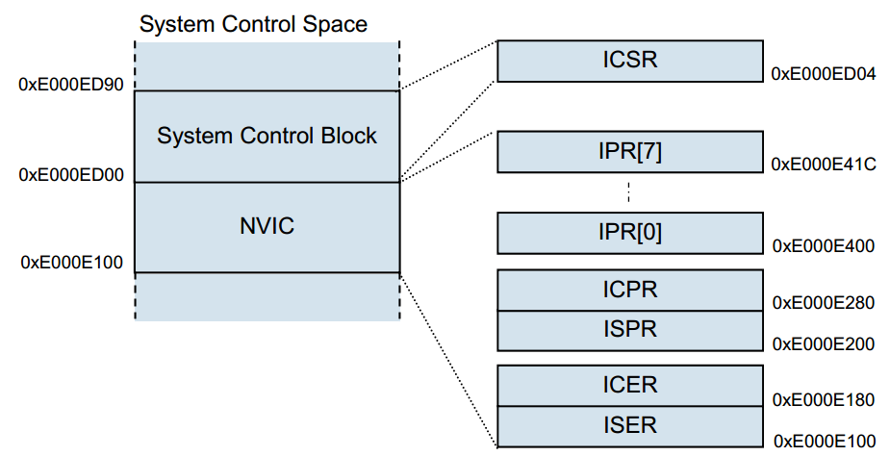
Details of NVIC & SCB registers
SCB & NVIC Register Set for Cortex M0
Notes:
ISER Interrupt Set Enable Register
ICER Interrupt Clear Enable Register
ISPR Interrupt Set Pending Register
ICPR Interrupt Clear Pending Register
IPR[0] to IPR[7] Interrupt Priority Register

Slide 15
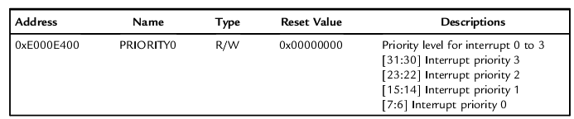
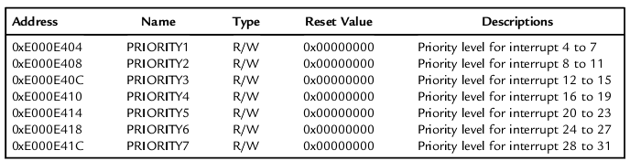
Details of NVIC & SCB registers
NVIC registers
Interrupt Priority Level Register (IPR0 – IPR7):
Notes:
Interrupt Priority Level:
Each external interrupt has an associated priority-level register. Each of them is 2 bits wide, occupying the two MSBs of the Interrupt Priority Level Registers. Each Interrupt Priority Level Register occupies 1 byte (8 bits).
The Interrupt Priority Level Registers should be programmed before the interrupt is enabled. Changing of interrupt priority when the interrupt is already enabled should be avoided, as this is architecturally unpredictable in the ARMv6-M architecture and is not supported in Cortex-M0 processor.

Slide 16
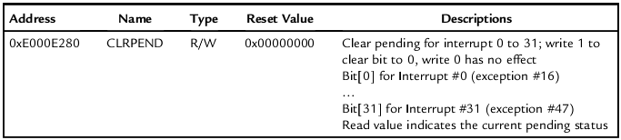
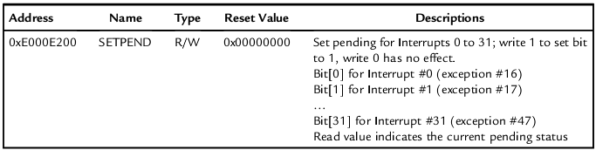
Details of NVIC & SCB registers
NVIC registers
Interrupt Clear Pending Register
Interrupt Set Pending Register
Notes:
If an interrupt takes place but cannot be executed immediately (for instance, if another higher-priority interrupt handler is running), it will be pended.
The interrupt-pending status can be accessed through the Interrupt Set Pending (NVIC->ISPR) and Interrupt Clear Pending (NVIC->ICPR) registers.
Interrupt Set Pending Register: Write 1 to set pending status
Interrupt Clear Pending Register: Write 1 to clear pending status

Slide 17
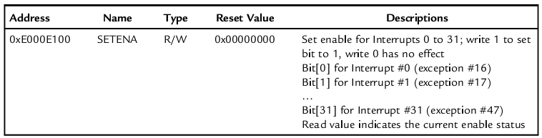
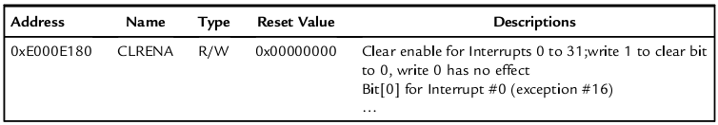
Details of NVIC & SCB registers
NVIC registers
Interrupt Set Enable Register
Interrupt Clear Enable Register
Notes:
Interrupt Set Enable Register:
Interrupt Clear Enable Register:

Slide 18
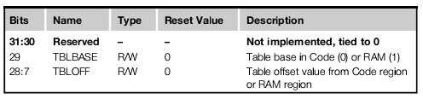
Details of NVIC & SCB registers
SCB registers
Interrupt control and state register
Set and clear the pending status of system exceptions including SysTick, PendSV, and NMI.
Determine the currently executing exception/interrupt number by reading VECTACTIVE
Vector table offset Register
Notes:
Note: VTOR is optional on Cortex M0+/ not available on Cortex M0

Slide 19
Table of contents
Overview of interrupt management
Vector Table
Details of NVIC & SCB registers
Exception Sequence
Exception handling optimization
Summary

Slide 20
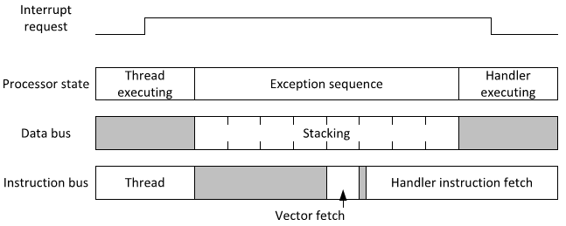
Exception Sequence
An exception entrance sequence contains:
Stacking of a number of registers
Fetching the exception vector
Fetching the instructions for the exception handler to be executed.
Update NVIC and core registers
Notes:
Note:
Stacking of a number of registers: If the processor was in Thread mode and was using the Process Stack Pointer (PSP), the stack area pointed to by the PSP will be used for this stacking. Otherwise the stack area pointed to by theMain Stack Pointer (MSP) will be used.
Fetching the exception vector: This can happen in parallel to the stacking operation to reduce latency.
Update of various NVIC registers and core registers: including: xPSR, MSP/PSP base on kind of used stack; PC, LR.
Link Register (LR) is updated with a special value called EXC_RE-TURN. This value is 32-bit, and the upper 27 bits are set to 1. Some of the lower 5 bits are used to hold status information about the exception sequence (e.g., which stack was used for stacking). This value is to be used in the exception return.

Slide 21
Exception Sequence
Exception handler execution:
The processor is in Handler mode
Nested Interrupt: If a higher-priority exception arrives, the currently executing handler will be suspended and pre-empted
Notes:
Note:
The processor is in Handler mode when executing an exception handler. In Handler mode:
• The Main Stack Pointer (MSP) is used for stack operations
• The processor is executing in privileged access level
Nested Interrupt: If a higher-priority exception arrives during this stage, the new interrupt will be accepted, and the currently executing handler will be suspended and pre-empted by the higher-priority handler. If another exception with the same or lower priority arrives during this stage, the newly arrived exception will stay in the pending state and will be serviced when the current exception handler is completed

Slide 22
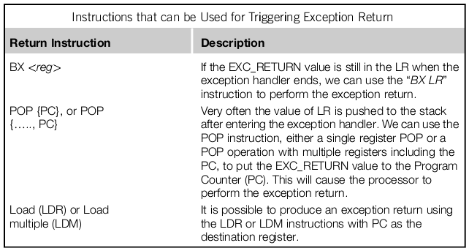
Exception Sequence
Exception return:
Notes:
In ARM Cortex-M processors, the exception return mechanism is triggered using a special return address called EXC_RETURN. This value is generated at exception entrance and is stored in the Link Register (LR). When this value is written to the PC with one of the allowed exception return instructions, it triggers the exception return sequence.

Slide 23
Exception Sequence
Exception return:
Unstacking: Restore Registers in the stack memory
Update NVIC & core Registers
Fetch the instructions of the previously interrupted program.

Slide 24
Table of contents
Overview of interrupt management
Vector Table
Details of NVIC & SCB registers
Exception Sequence
Exception handling optimization
Summary

Slide 25
Exception handling optimization
Tail chaining
Late arrival
Pop preemption
Lazy stacking (Only support for Cortex M4 with FPT)

Slide 26
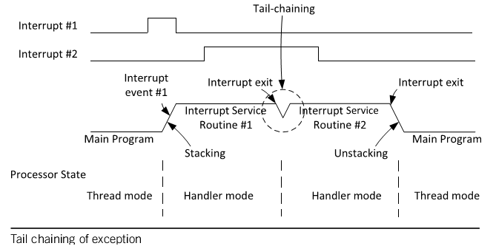
Exception handling optimization
Tail chaining:
Notes:
When an exception takes place but the processor is handling another exception of the same or higher priority, the exception will enter the pending state. When the processor finishes executing the current exception handler, it can then proceed to process the pending exception/interrupt request. Instead of restoring the registers back from the stack (unstacking) and then pushing them on to the stack again (stacking), the processor skips the unstacking and stacking steps and enters the exception handler of the pended exception as soon as possible.

Slide 27
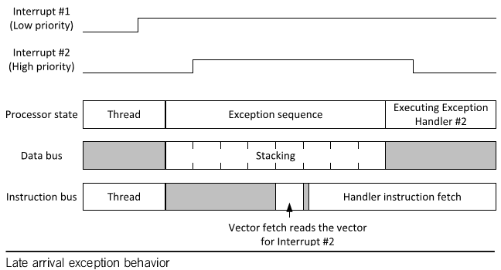
Exception handling optimization
Late arrival:
Notes:
When an exception takes place, the processor accepts the exception request and starts the stacking operation. If during this stacking operation another exception of higher priority takes place, the higher priority late arrival exception will be serviced first.

Slide 28
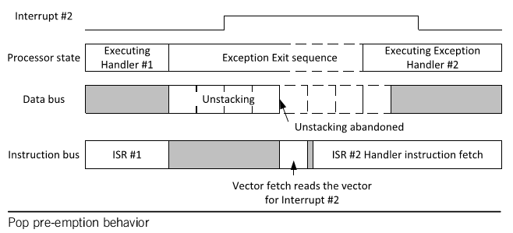
Exception handling optimization
Pop preemption:
Notes:
If an exception request arrives during the unstacking process of another exception handler that has just finished, the unstacking operation would be abandoned and the vector fetch and instruction fetch for the next exception service begins. This optimization is called pop pre-emption.

Slide 29
Table of contents
Overview of interrupt management
Vector Table
Details of NVIC & SCB registers
Exception Sequence
Exception handling optimization
Summary

Slide 30
Summary
Cortex-M provides a Nested Vectored Interrupt Controller (NVIC) for interrupt handling.
Exception entry sequence: Staking, Update registers, Fetch vector number & instruction of exception handler.
Exception return sequence: Unstacking, Fetch & execute from the restored return address
Exception handling optimization: Tail chaining, Late arrival, pop preemption.

Slide 31
Question & Answer
Thanks for attention !
Notes:
Trả lời các câu hỏi của học viên nếu có.

Slide 32
Copyright
This course including Lecture Presentations, Quiz, Mock Project, Syllabus, Assignments, Answers are copyright by FPT Software Corporation.
This course also uses some information from external sources and non-confidential training document from Freescale, those materials comply with the original source licenses.

